Slide 1

Program: ESE 4009
INSTRUCTOR: Prof. Mike Aleshams
Group 6
Rohan Yadav C0773871 Shahrukh Padaniya C0769542 Swapnil Sevak C0777195 Vandana Ega C0777215
Presented by: SWAPNIL SEVAK

Slide 2

Project : Iot based cradle using SIDS monitor

Slide 3
PIR SENSOR INTERFACING WITH RASPBERRY PIE

Slide 4
CONTENTS
INTRODUCTION
BLOCK DIAGRAM
RASPBERRY PI SET UP
VNC VIEWER
PIR SENSOR INTERFACING

Slide 5
INTRODUCTION:
IOT based cradle using SIDS monitor system works as a helping assistant of a mother who specializes in baby’s health monitoring.
This system provides alert in an emergency case, if the baby stops breathing or heart rate is not detected, so it will grab the attention of parents so that they can take action immediately. In addition to that, there will be video camera attached to it, so that parents can monitor remotely.
Cry detection circuits will analyse cry patterns and give information to parents if crying activity persists for a long time and activates swing of cradle . Wetness will be detected if baby urinate in the bed and provide alert to parents.
All sensors are always connected to the internet and GSM Module provide information through user friendly android apps. This app will have feature of swing control when baby is crying, switching to video surveillance.

Slide 6
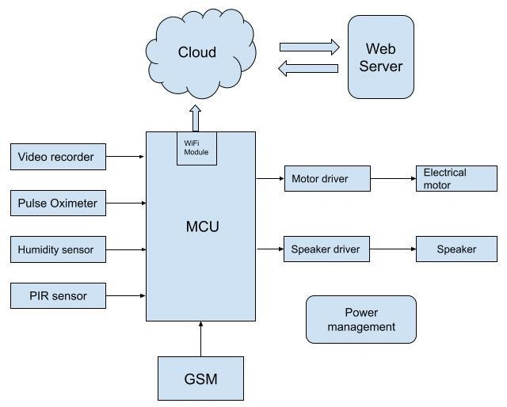
Block Diagram

Slide 7
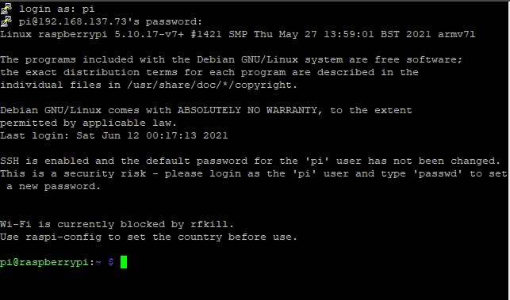
Raspberrry pi interfacing

Slide 8
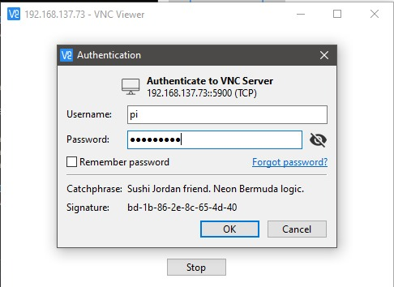
VNC viewer

Slide 9

PIR Sensor
Here PIR itself states for Passive Infrared Sensor.
PIR sensors detect motion and are virtually always used to determine whether a human has entered or exited the sensor's range.
They're small, cheap, low-power, simple to use, and they don't wear out.
As a result, they're often found in home and business equipment and gadgets.
PIR motion sensors are also known as "Passive Infrared,“ "Pyroelectric," or "IR motion" sensors.

Slide 10
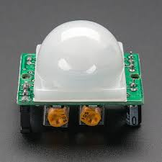
PIR Sensor

Slide 11
PIR sensor
We're utilising a PIR motion sensor here.
A fresnel lens, an infrared detector, and associated detecting electronics make up this motion sensor.
Any infrared radiation existing surrounding the sensor is focused toward the infrared detector by the lens on the sensor.

Slide 12
PIR sensor
Infrared heat is generated by our bodies, and the motion sensor detects this heat.
As soon as it senses the presence of a human, the sensor emits a 5V signal for one minute.
It has a detection range of around 6–7 metres and is quite sensitive.

Slide 13
PIR sensor
When the PIR motion sensor detects a person, it sends a 5V signal to the Raspberry Pi's GPIO, and we use Python code to describe what the Raspberry Pi should do when it detects an intruder.

Slide 14
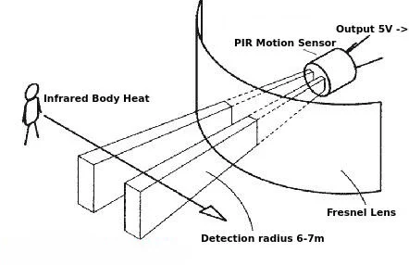
PIR sensor

Slide 15
PIR sensor interfacing
A Python application may be used to access the Raspberry Pi's GPIO.
Here I would like to discuss how to access these pins and the instructions we need to do so.
The Raspberry Pi's pins are labelled according to their order (1,2,3,...), as illustrated in the picture below:

Slide 16
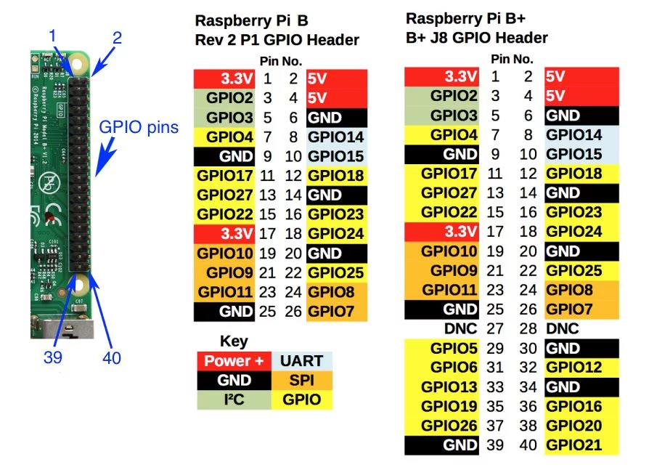
Raspberry Pi Pin Label

Slide 17
PIR sensor interfacing
We can attempt reading the PIR motion sensor's output.
When the sensor identifies a human, it sends out a digital HIGH (5V) signal.
In our Raspberry Pi, copy and paste the following code.

Slide 18
Code
#include <wiringPi.h>
#include <stdio.h>
#include <stdlib.h>
#define PIRPin 0

Slide 19

Code
int main(void)
{
// When initialize wiring failed, print message to screen
if(wiringPiSetup() == -1)
{
printf("setup wiringPi failed !");
exit(1);
}

Slide 20
Code
pinMode(PIRPin,INPUT);
printf("\n"); printf("========================================\n"); printf("| Alarm |\n");
printf("| ------------------------------ |\n");
printf("| PIR connect to GPIO0 |\n");

Slide 21
Code
printf("========================================\n"); printf("\n");
while(1)

Slide 22

Code
{
if(!(digitalRead(PIRPin))){
printf("\n");
printf("-------------------|\n");
printf("| Object detected |\n");
printf("-------------------|\n");
delay(1000);
}

Slide 23
Code
else
{
printf("| Object not detected |\n");
delay(500);
printf("\n");

Slide 24
Code
printf("===================|\n");
printf("| alarm... |\n");
printf("===================|\n");
}
}
return 0;
}

Slide 25
Compile Code
To run the code we need to type command as below.
gcc -Wall -o pirsensor pirsensor.c -lwiringPi

Slide 26
Run the code
To run the code we need to type command as:
sudo ./pirsensor

Slide 27
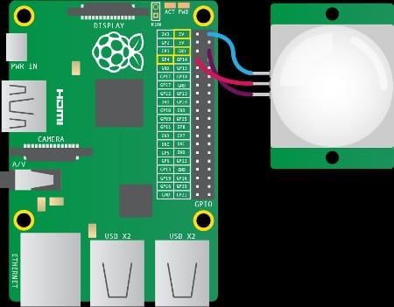
Interfacing

Slide 28
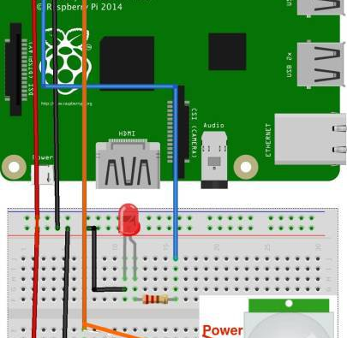
Interfacing

Slide 29
References
ADA fruit. “ADA fruit.” ADA fruit, 2021, https://learn.adafruit.com/pir-passive-infrared-proximity-motion-sensor. Accessed 28 06 2021.
Maker pro. “Maker pro.” Maker pro, 2021, https://maker.pro/raspberry-pi/tutorial/how-to-interface-a-pir-motion-sensor-with-raspberry-pi-gpio. Accessed 29 06 2021.

Slide 30
THANK YOU

